Slide 1
2020 Post Covid appraisals:
Professor amelia Hadfield, Head of the department of politics
Founder & director of the Centre for Britain and Europe
University of surrey
a.hadfield@surrey.ac.uk

Slide 2
Reviewing today’s issues
How will the crisis affect the balance of power - weakening some states and strengthening others?
Will the major trading nations return to a broad economic consensus or continue to fragment into hostile tribes, blaming each other?
Will globalisation go into reverse as countries hunker down and seek to be more self-sufficient - or will it herald a new era of international co–operation?
How will the hit to the US economy affect Trump’s chances of re-election?
Will countries with weakened economies seek refuge in populism, or revert to ‘safer’ traditional political parties?
Will the crisis change our habits to the point where it has an effect on climate change & energy usage?
Will the dispute over central bank intervention stretch EU unity to its limits?
Brexit Redux?

Slide 3
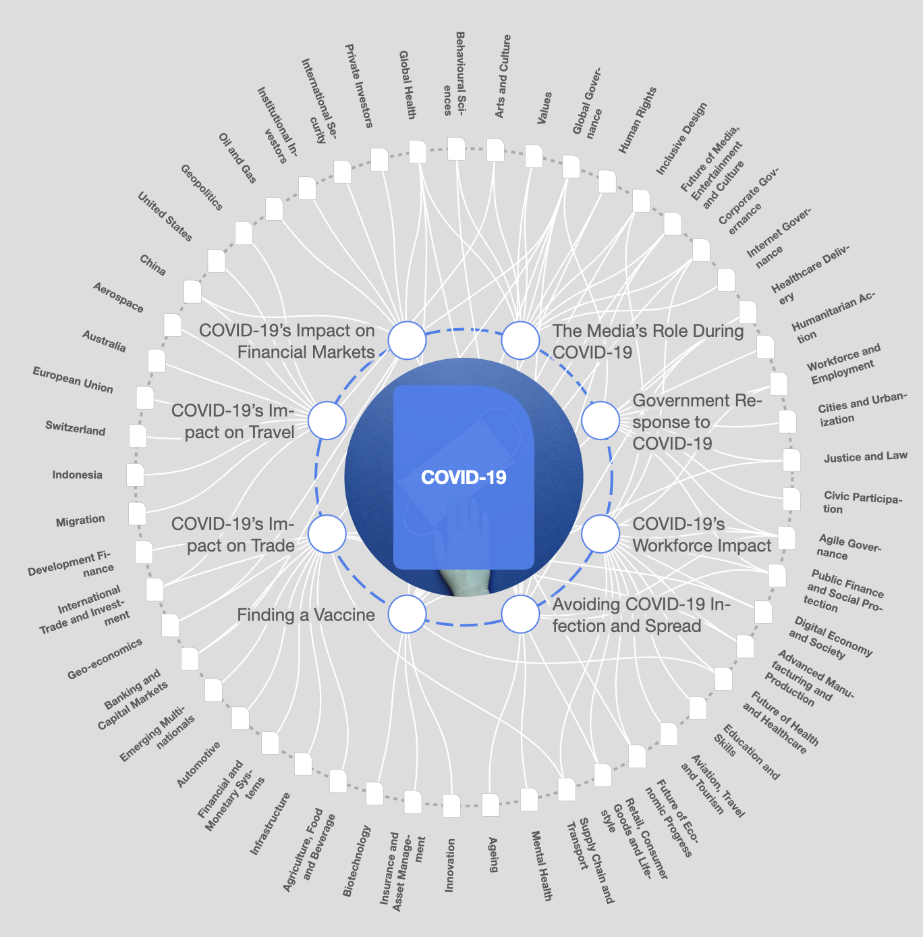

Slide 4
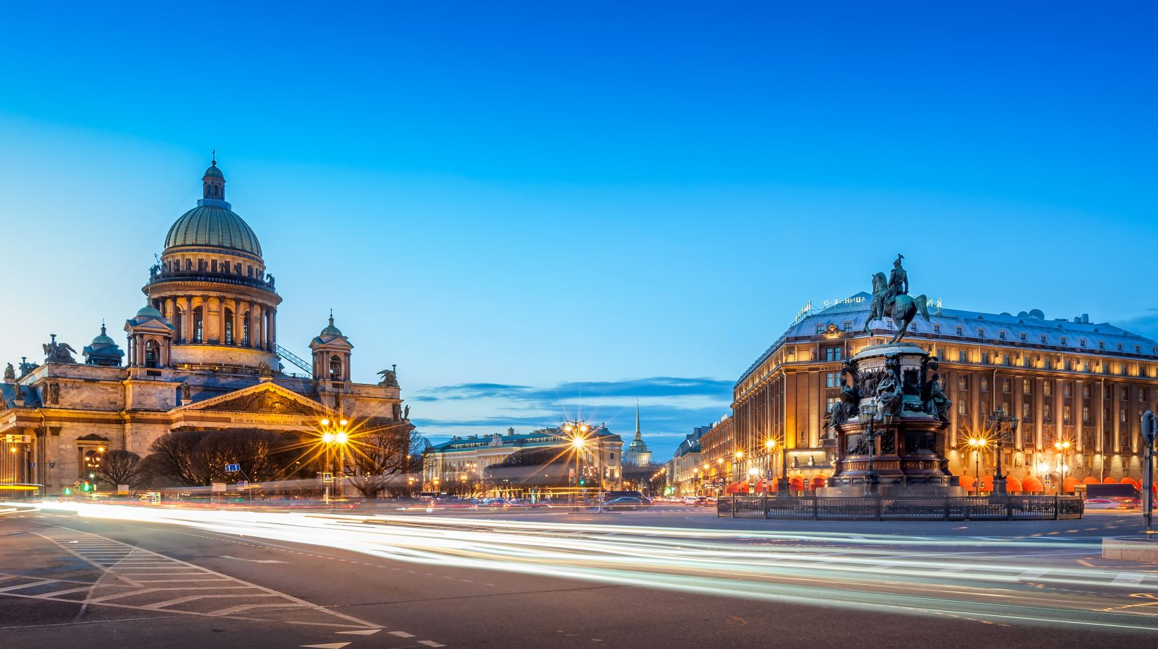
Balance of Power
Genuinely pivotal global moment determined by the scope of behavioural change on states, governments, leaders and institutions;
Working more closely? Bringing some states together
Underscoring need for regional & institutional cooperation
Renewal of climate change and transformative public policy options
Retreat from hyper-globalisation or reworking of aspects of cross-supply chains?
Resetting global, national and personal landscapes
Divided trauma: reinforcing the state, nationalism and populism (India, Brazil, Turkey)
Adopting emergency measures to manage Covid, loathe to relinquish them post-crisis (Putin, Orban, Trump)
US/Europe slow & haphazard response vs. China, South Korea, Singapore lockdowns
China-US blame game; accelerating west to east power shifts
North/south rifts
Multilateral cynicism? Lacklustre WHO

Slide 5
Response and responsibility
Politicized: Covid into a soft power tool in tackling the pandemic (widespread perception of gross incompetence in the US vs. centralized authoritarian rule in China) EU, IGOs sparring over responsibility
Weaponising Covid for political ends? US sidelining itself from acting as a global crisis leader while placing its citizens in unnecessary peril; China spats
Combination of established centralized rule in key states (China, Russia) & mainstreamed populist govt’s (India, Brazil, Hungary, Poland)
Unprecedented government aid packages for business & workers: ‘the state is back’? The limits of postwar neoliberal, free market model?
Yes: only states can offer national packages, and mobilise nationally to rebuild their economies & health care systems
Yes: Covid as the historical marker between globalization 1.0, and 2.0 in which great-power blocs with local/regional supply chains
States limit future exposure to global threats economically and internationally

Slide 6
Resilience and paranoia
Covid and consequences: a game-changer for poorer countries with limited resources for recovery
UN report: ‘potential to wreak havoc in fragile states & trigger widespread unrest, impossible to control in densely packed urban centres’
Hasn’t yet happened, BUT has disrupted global food supply chains: famine imminent in some countries & disrupted humanitarian aid in others (Syria, Afghanistan, Somalia, South Sudan and Yemen)
UN $2bn aid appeal for ‘humanity fightback’
Nationally, covid has exposed an endemic lack of resilience: chronically under-resourced healthcare systems, weak social cohesion, unclear protocol
International: cooperation boosted if lackluster at UN, WHO, WTO, with willingness to pursue dialogue
Avoid: globally debilitating US-China passive-aggressive fight for supremacy
Democracies: emerging to attempt a new type of pragmatic and protective internationalism

Slide 7
Globalisation: State-based sufficiency or new era of international cooperation ?
2008 collapse: impact on banks, MNCs, trade & FDI
Trump’s trade wars: blue-collar focus & anti-China chauvinism
Covid: factors, shop & office closures causing demand to tumble, supply chains severed
Demonstrates anarchy of global governance? Cynicism: role of UN, EU, WHO & multilateralism
Public opinion shifting national responses /views
Clear examples of populist governments using Covid and recovery to enhance electoral/authoritarianism
Targeting China, curtailing immigration
The impacts mustn’t become the norm:
Global movement of people, goods & capital to ensure resuscitation of global flows
Travel needed to find work, open/inspect plants, begin manufacturing
Trade & manufacturing can’t be reduced to domestic source and reduced access
Despite the national orientation of stimulus packages, governments need to resist entirely domesticating supply chains to support ‘resilience’
Judge subsidies & state aid carefully
Capital flow, trade partners & FDI are a key part of the monetary and fiscal response

Slide 8
International advice: Roberto Azevedo WTO director general
Covid impacts include plummeting commodity prices, export earnings decline, reduction of FDI, and drop-off in remittances, supply/demand shocks to international trade affect supply and value chains
Air freight capacity down while ocean shipping comparatively spared; impact still reduces the bulk of trade in manufactured items, food, energy and raw materials.
Trade volumes to fall 13-32% this year (2008/9: 12% drop), on par with Great Depression (1929-32).
Monetary and fiscal recovery largely directed by national governments: $ multi-trillion packages to prevent debt default, bankruptcy and job losses.
Trade: the 3rd component of a strong recovery.
“While some favoured industries might benefit from heavy-handed attempts to create wholly national supply chains, many more would lose, and so would consumers already hit by the recession. This would place a brake on recovery; in the longer term, the loss of specialization and scale would lower growth and productivity… Supply chain diversification would be better served by predictable global trade rules than by haphazard protectionism”.
Notes:
‘Global trade will be vital to economic recovery from Covid-19’, The Guardian, 17/05/2020

Slide 9
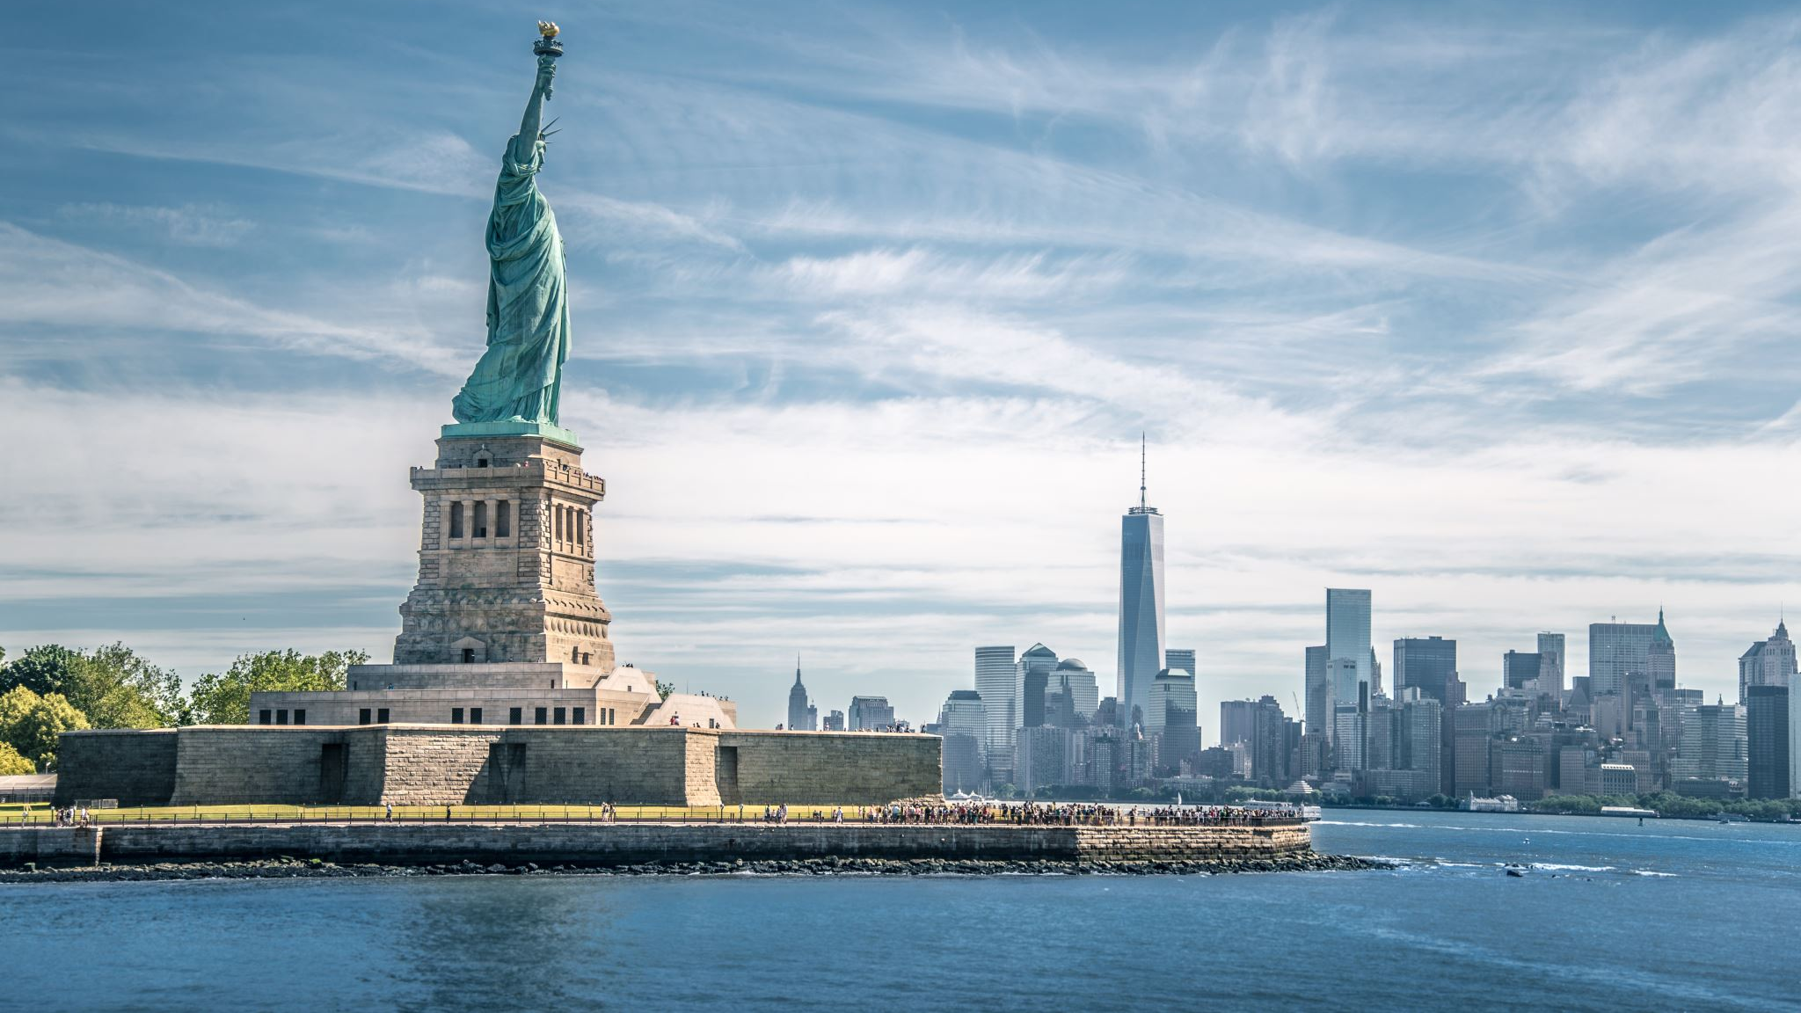
How will the hit to the US economy affect Trump’s chances of re-election?
Voter choice far more correlated with feelings on coronavirus than the economy
Industrial Midwest (Pennsylvania, Minnesota, IOWA, Wisconsin, Michigan): new front line for American’s lives & Livelihoods combining corona hotspots and record unemployment
Pre-corona trends of industrial output decline, undermined workers; sharpened partisan divides.
Trump: US corona recovery as ‘the transition to greatness’ vs. increased trust in state governors
Trump badly challenged by corona handling & ultimately now losing to Biden overall
Trump more than holding his own on the economy;
Latest CNN/SSRS national poll puts Trump’s April & May approval rating on the economy at 50% (49%: 2018 midterms)
12 points ahead of Joe Biden
Americans are giving Trump a lot of slack given the pandemic with concern to the economy,
But largely because they believe the economy will recover quickly, and see the current problems as temporary obstacles

Slide 10
Trump’s election strategy: up with the dow jones & down with china
US economy has shrunk by 4.8% annual rate in 2020 first quarter
Trump now largely abandoning public health strategy in favour of economic boosting, scrapping task force briefings for ‘America Together: Returning to Work’
Dr Anthony Fauci (US Infectious Diseases) warns of a rebound of new cases if the US rushes towards premature reopening of business & society
‘They’ve decided that the political damage from a collapsed economy is greater than losing as many as 90,000 Americans just in June… it’s a grisly realpolitik’ (Rick Wilson, Republican strategist)
Decision-making guided largely by re-election prospects
Trump accusing Beijing of ‘doing anything they can’ to lose his 2020 re-election
Increasingly blaming China for the pandemic, from origin to spread to recovery
Republican candidates encouraged to aggressively target Beijing in public remarks on the pandemic
Accuses China of undermining the trade deal concluded with Xi Jinping in Jan 2020
Argues Biden is Beijing’s preferred candidate to ease the pressure on US-China trade relations
China ‘resolutely opposes’ international investigations into the pandemic as deeply stigmatizing

Slide 11
Will countries with weakened economies seek refuge in populism, or revert to ‘safer’ traditional political parties?
YES
Right-wing and nationalist populist movement mainstreamed in movements and parties in many countries
Populism lite: temporarily dismantling established democratic institutions without a clear replacement (India, Israel)
Populism plus: using Covid shutdown measures to strategically harness state powers and build an authoritarian alternative: Hungary, Poland, Russia.
Problem: Pre-crisis problems created an atrophy, but the original deep social challenges are still there, likely deepened with covid impacts.
NO
Flippant, opportunistic forms of populism now out of vogue
Covid compels leaders to mobilise the full capacity of the state and institutions (civil service, academia, journalists, experts) instead of deriding them
Johnson & Cummings: about-face in dealing with the media and experts, to ensure the statesmanlike method and the ‘rally round the flag’ effect, pragmatic issue-based patriotism rather than populism

Slide 12
Covid populist Consequences?
Sources of populism? Disillusionment, nationalism, protectionism, increased cultural polarization
For populists in opposition, drawing on any examples of these in the government’s handling of the crisis is fertile ground for producing a backlash against establishment parties.
For populists in government, blame regarding the origin, handling and consequences of a crisis is largely directed towards incumbents, with personal blame attached
The impact of regional and international cooperation in solving problems; isolating populist governments, revealing the economic consequences of isolationism itself
Pandemic seen to touch everyone and not obviously socially partisan (equally, good evidence of uneven class-specific impacts of lockdown)
Difficult to run elections during pandemic period, with low turnout of populist supporters

Slide 13
Will the crisis change our habits to the point where it has an effect on climate change?
Big opportunities with key policies to get economies moving again
Install fire-optic broadband and 5G
More space for pedestrians and cyclists (London, New York, Barcelona, Madrid) to. Expand space allotted for cyclists to reduce crowded public transport systems
Levying new fossil-fuel taxes, and removing subsidies for oil, gas and coal to provide additional income for cash-strapped municipalities
Install electric-vehicle charging networks to encourage systemic switch to electric vehicles and get national networks in place
Expand cleaner public transport by using stimulus funding/low-interest borrowing for wholesale electric switches
Building climate-resilient infrastructure (seawalls, dikes, major reforestation and electrification)

Slide 14
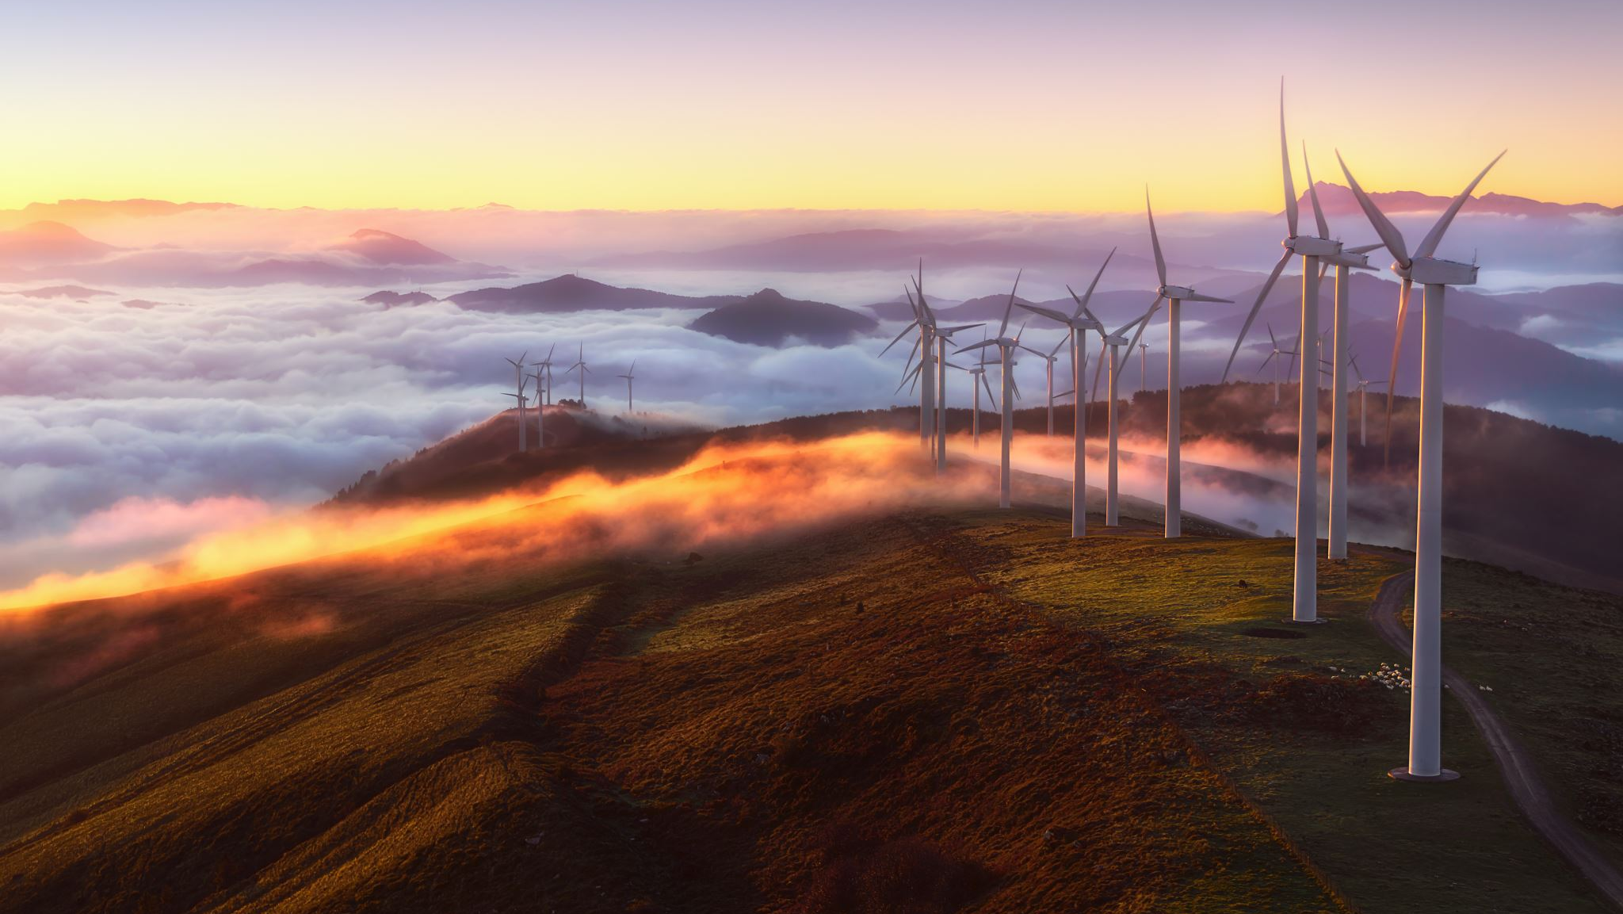
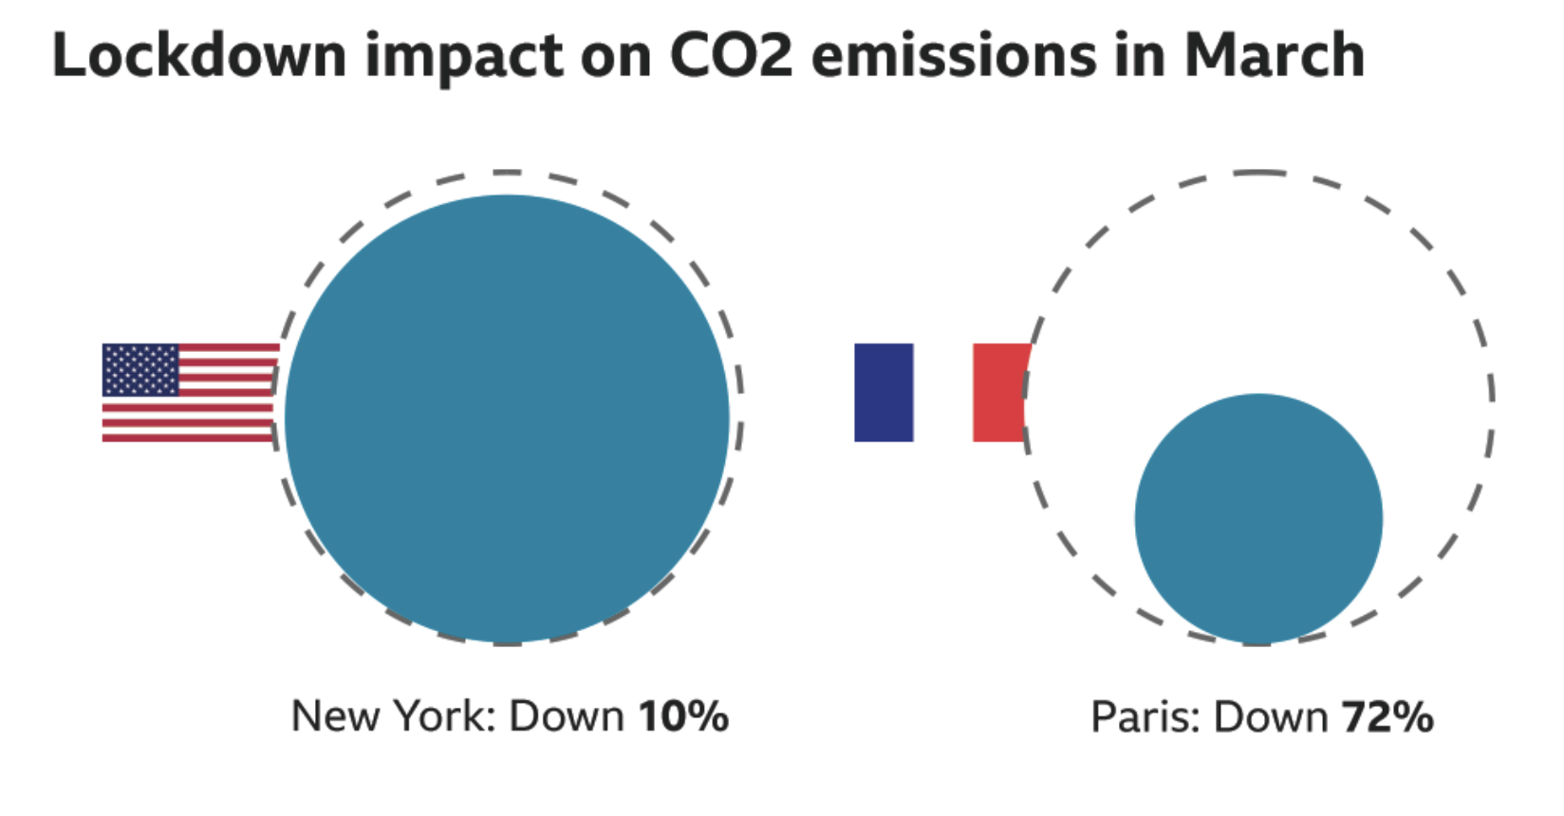
Climate change: Generalities

Slide 15
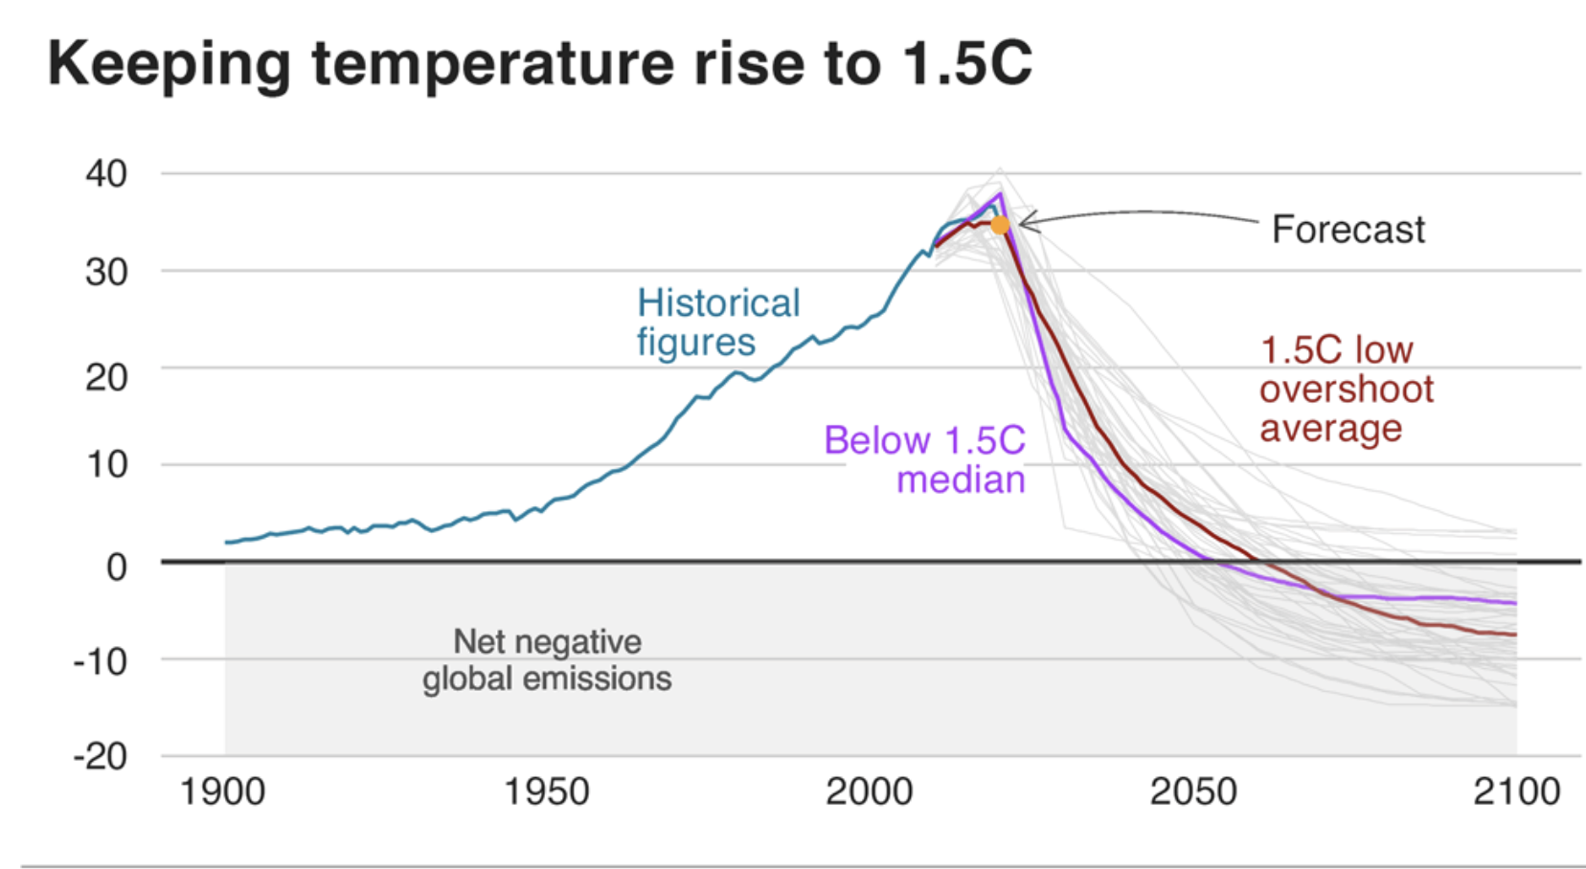
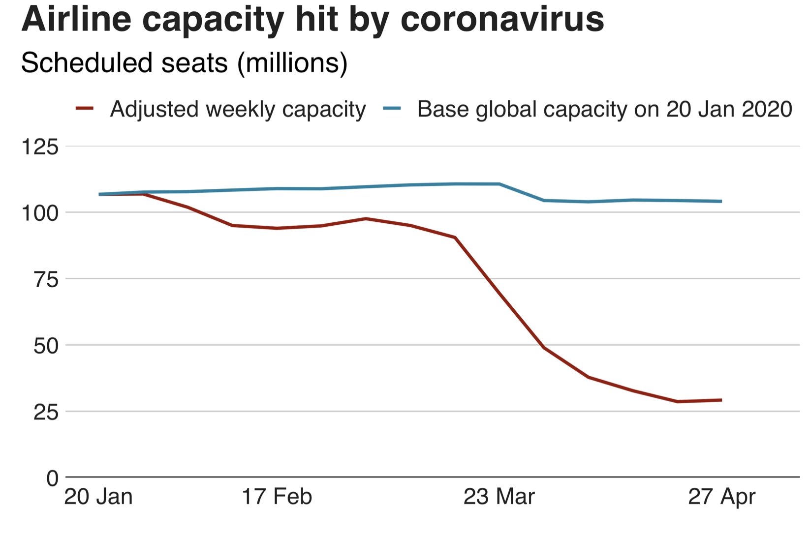

Slide 16
Covid’s impact on carbon & emissions trading
From 9-22 March, every European country saw electricity demand fall 2-7% week on week.
Steep electricity reductions and industrial outputs means significant reductions in demand for carbon permits, in turn promoting a fall in government revenues from auctioning permit, and a corresponding drop in EU carbon permit prices.
Question: will the ETS’ reforms prove agile enough to prevent a sustained fall in permit prices this time around?
Emissions have declined in parallel, but the ETS response is largely unplanned and chaotic, possibly promoting inequities.
Need to keep prices at €30. per tonne to maintain fuel switching in key power sectors (particularly Germany).
Commodities down by 23%, carbon down by 30% (March-May)
EU Emissions Trading Scheme overhauled post 2008, its cap-and-trade structure rendered more flexible to prevent the oversupply of permits, via the Market Stability Reserve (MSR) which since 2019 adjusts the supply of allowances to be auctioned.

Slide 17
Will the dispute over central bank intervention stretch EU unity to its limits?
Delayed judgement to the German constitutional court challenging the bond-buying programme of the ECB
2008: ECB bought the debt of economically weaker EU MS to reduce borrowing costs & prevent a debt spiral, directing national banks to do so.
Court: ruled the ECB failed to conduct a ‘proportionality analysis’ of the effect on public debt, personal savings, pension schemes, subsidies etc.
Ordered the German central bank to STOP buying bods without an ECB assessment.
Reworking the lending of the ECB and the ESM? Yes, so as not to jeopardise current bond-buying efforts and prevent a run on Italian debt.
Unraveling the EU? Unlikely, especially with Merkel’s strengthened hand & clearly advocating for a solution.
EU Budget: being radically reset to incorporate Von der Leyen’s Green Deal, and Regional Resilience building..

Slide 18
EU update
Merkel and Macron roll out €500 billion COVID-19 recovery plan: €500 billion European r programme seeking to bring Europe out of the crisis “united and in solidarity” & intended to provide support “to the sectors and regions most severely affected,” given as grants, not loans.
Boosts: resilience, convergence, and competitiveness of the European economies + health care overhaul ( 4 goals, lining up the European Commission goals).
New EU capital markets union strategy: EU institutions & MS working on a “massive” fiscal stimulus to combat the deepest envisaged recession in the EU history: “The capital markets union action plan belongs to the key policies of the Commission and will have extra relevance in the recovery context, to make sure that European companies receive sufficient financing”. Goal: supporting equity and equity-like investments to protect workers and (the) financial sector, using the strategy to diversify funding sources for companies”.

Slide 19
Mid-range diplomacy? Scientific community & the G20
Radical cross-border cooperation by the scientific community : ‘the new international’; reinforcing measures taken at national levels
Competition: vaccine development
Collaboration: epidemiological best practice
G20: informal network of policy makers (account for 80% world economy) founded in. 2008 crisis to provide emergency funding, & stabilized global financial system
Now?
Boost scientific & medical cooperation, particularly vaccine financing & distribution
Support short & long-term funding via UN, IMF, World Bank to poorest states, starting with their health care systems
Push ahead with economic, financial & trade measures to combat global contractions

Slide 20
Brexit: Deal or no deal?
Brexit Day: 31st January 2020. Withdrawal Treaty entered into force (covers UK £ settlement, UK-EU citizens rights and UK/NI customs border)
Talks enter Phase 2: Trade Deal + concurrent talks on ‘level playing field’, fisheries, internal security & governance.
Transition expires 31st December 2020. Can be extended; request must be made by 30th June 2020.
Northern Irish Protocol in effect Jan 1 2021 with or without a deal; no border checks but Northern Irish ports checks.
During the transition, Britain remains within the Single Market and Customs Union and under the rules of the EU, including jurisdiction of CJEU. However, it loses its seat at the EU Council and MEPs.

Slide 21
Extending Brexit transition?
General feeling: Economic impact of Covid so great, negotiations so complex between UK, EU & MS, and discussions so far behind: UK must extend for the permissible 2 years under WA terms
UK needs to ask for/be offered prolongation by 30th June;
Barnier: virtual negotiations behind schedule (by 3 weeks) and disappointing in 4 areas: level playing field (extent to which UK adopts EU standards in exchange for access to EU Single Market), fisheries, security cooperation and governance issues.
“The pandemic will cause more economic damage than we can now imagine. To think that you could then add to this extraordinary situation a very disorderly exit... is not in the British interest, or in the interest of any of us” – Norbert Röttgen, Chair of Bundestag’s Foreign Affairs Committee
MEP David McAllister (chair of UK coordination in European Parliament) “both sides are now under enormous time pressure to organize even a half-way orderly exit of the UK from the Single Market and Customs Union’
Problem: Johnson has to reverse legislation that currently bars him from seeking an extension & requires additional financial contributions to the EU during the extension

Slide 22
3 recent developments
1. The European Commission has launched legal action against the UK for ’failure to comply’ with EU rules on the free movement of people, citing a string of shortcomings in the UK’s handling of citizens’ rights since 31st January 2020 transition period:
The Commission’s infringement notice claims that current UK law ‘limits the scope’ of EU citizens in the UK, curbing their ability (and their family members) ‘to appeal administrative decisions restricting free movement rights’, constituting a breach in EU directives on free movement of EU citizens, workers, & freedom of establishment. UK has four months to respond.
2. UK gov’t has conceded there will be post-Brexit checks on goods crossing the Irish sea, via border control posts at Belfast, Warrenpoint and Larne ports.
UK gov’t will ‘urgently put in place detailed plans with the [NI] executive including physical posts at ports of entry’. Animals, agri-food checks exist now, but wholly new import/export protocol/forms now needed.
3. UK Global Tariff Plan: DIT announced its post-Brexit tariffs regime, cutting import duties on many products while protecting industries such as automotive and agriculture: £30 billion ($36.6 billion) of tariffs removed on supply chain imports, including copper alloy tubes, and screws and bolts, the department said.

Slide 23
Further reading
http://www.lse.ac.uk/GranthamInstitute/news/covid-19-emissions-trading-and-the-implications-for-a-uk-ets/
https://www.economist.com/leaders/2020/05/14/has-covid-19-killed-globalisation
https://www.chathamhouse.org/expert/comment/hurdles-developing-covid-19-vaccine-why-international-cooperation-needed
https://fpc.org.uk/the-impact-of-covid-19-a-case-for-maintaining-external-aid-commitments-and-international-cooperation/
https://oilprice.com/Energy/Crude-Oil/7-Oil-Countries-Hit-Hard-By-The-COVID-19-Crisis.html
https://edition.cnn.com/2020/05/15/politics/trump-economy-analysis/index.html
https://www.politico.com/news/2020/05/14/coronavirus-economic-collapse-rust-belt-trump-259657
https://voxeu.org/article/political-participation-populism-and-covid-19-crisis
https://bfpg.co.uk/2020/04/covid-19-populism/
https://theconversation.com/are-populist-leaders-a-liability-during-covid-19-135431
http://www.climateaction.org/webinars/covid-19-what-does-this-mean-for-the-fight-against-climate-change
https://www.imperial.ac.uk/news/197473/how-will-coronavirus-shape-response-climate/
https://www.irishtimes.com/news/world/europe/how-a-german-court-fired-a-shot-that-could-unravel-the-eu-1.4252763
https://foreignpolicy.com/2020/05/13/european-central-bank-myth-monetary-policy-german-court-ruling/
https://www.bloomberg.com/news/articles/2020-05-19/u-k-sets-out-post-brexit-tariffs-plan-cutting-import-duties

